Slide 1
Questioned Documents
Chapter 21

Slide 2
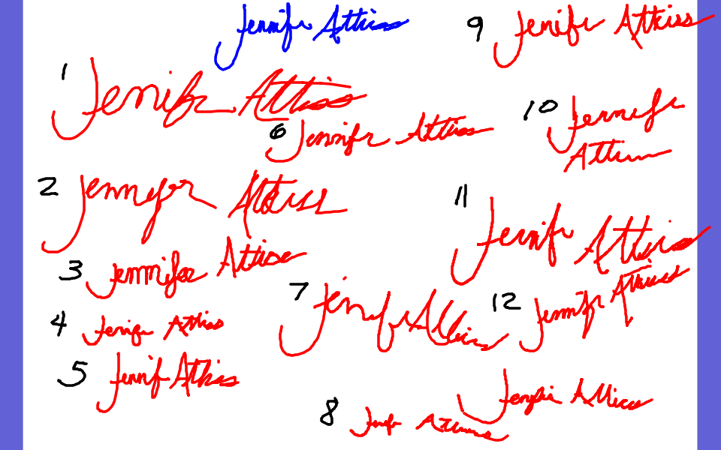

Slide 3
Answer= #5

Slide 4
I. What is a questioned document
= one that is entirely or in part suspect as to the authenticity or origin
Examples:
→Commonly think of—checks, wills, and contracts
→Also include—typewritten letter, dollar bill, postage stamps,
receipts, concert tickets, etc.

Slide 5
II. History of role in forensic science
The field of questioned documents = one of the oldest in forensic science
Albert S. Osborn= pioneer of the field
Lindbergh baby kidnapping case = important in establishing to the legal system the role of document examiner (ransom note)
Now . . .
--document examiner must always be prepared to state opinion in court and demonstrate how formed opinion
--beyond college one needs on-the-job training/internship before become document examiner and then keep up with latest in the field

Slide 6
III. Handwriting analysis
Theory of handwriting
No two people have the same handwriting . . .why?
1. Neuromuscular coordination and visual perception differ between people
2. By time teenager, writing matured and has a unique style
KEY= “Handwriting is an acquired skill that becomes ingrained; it is habitual and individualized.”

Slide 7
B. Collection of Writing Standards
Before can begin examination, must collect writing standard . . . two types
1. Non-request writing= spontaneous or undictated
+ reveal most normal habits
- difficult to obtain enough comparable letters and words
2. Request writing= dictated
+ provide writing comparable to questioned material
- call attention to the writing process (nervousness and/or try to disguise own writing)

Slide 8
C. Process of handwriting comparison
1. Visually and microscopically compare questioned document and known standards
side-by-side
Two principles of comparison
1--No two individuals write exactly alike
2--No one person writes exactly the same way twice
Keep in mind . . . an individual has a repetitive range to his/her writing and basic pattern or habitual style is still present

Slide 9
3. What experts look for????
Experts examine
. . . . class (features and dimensions of letters) and
. . . .individual characteristics (unique features of the letters)

Slide 10
12 Characteristics of handwriting =
line quality
spacing of words and letters
ratio of height, width, and size of letters
pen lifts and separations
connecting strokes
beginning and ending strokes
unusual letter formations
shading or pen pressure
slant
baseline habits
flourishes or embellishments
placement of diacritics

Slide 11
IV. Methods of Forgery
Three types:
1. Blind forgery or normal hand forgery = forger does not attempt to copy victims writing . . . writes in own writing style or tries to “disguise” it
--most common
--easiest to detect

Slide 12
2. Simulated forgery = attempting to copy the victims writing style
--working off of “model signature”
--must maintain speed, correct letter formations, height ratio, and pen pressure all at same time
--must also suppress own writing habits
--not hard to detect as forgery, but can be difficult to link to suspect

Slide 13
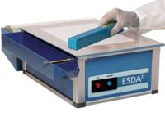
3. Traced forgery/Tracing = using original as a guide
--detected due to inconsistent line quality (i.e. shaky and slow)
--detected by indentation mark (oblique lighting or ESDA)
-ESDA = electrostatic detection
apparatus
http://www.alzomar.com/page.asp?page=Documents

Slide 14
Primary signs of forgery =
The appearance of being written slowly
Blunt line endings and beginnings
Poor line quality with wavering and tremors of the line
Retracing and patching
Stops in places where writing should be free and smooth
Inconsistent letter formation
NOTE: Software (CEDAR) available to assist in handwriting analysis . . . but cannot eliminate examiner b/c detail only detected by human eye.

Slide 15
***Simulated forgery activity***

Slide 16
V. Typewriting Examination
Evidence submission
--need typewriter in question or a sample from that typewriter
Examination
--typewriter make and model can be determined
--the older the machine, the better the possibility for identification
--identify through: type alignment, spacing, broken or damage font, ink density, and pressure

Slide 17
***Typewriter comparison Activity***

Slide 18
VI. Photocopy Examination
Detect “trash marks”
--include: debris, gripper marks, platen defects, and dirt on copier
Copier make and model may be detected
Material can be dated as these qualities can change over time
Photocopy forgery
--Detect: misaligned typing, different fonts or font sizes, incorrect margins, “shadowing” at jointed areas, and “trash marks”

Slide 19
VII. Obliterations
Methods =
1. Erase or scrape ink off surface
2. Use chemicals to make ink become colorless (ex. Chlorine or sodium hypochlorite)
Detection =
Microscopic examination
Infrared or UV light

Slide 20
VIII. Alterations and Ink
Detection =
Microscopic examination
Infrared or UV light (different inks react
differently to this light)
TLC (Thin Layer Chromatography)
--destructive test but definitive results
--use small “punches” from document in
question
--results in bands of color up a piece of
paper
--comparing bands can indicate if inks
from same source

Slide 21
IX. Paper
Examination necessary when questions about whether pages added to multi-page document.
Examine:
--staple marks
--paper composition: usually wood or cotton with certain fillers added
-chemical testing can detect materials present and associate with both a known standard and a manufacturer
--paper size and thickness
-line up in stack (small differences)
-micrometers used to detect thickness
--watermark (clues about manufacturer)

